Slide 1
Machine Learning
Lesson 1
Bryan Huang

Slide 2
Tools
Python
Matplotlib
Numpy
Sklearn
Tensor flow

Slide 3


Isolated Env
Why? like VMWare
VirtualEnv is the best
How
Activate and deactivate

Slide 4
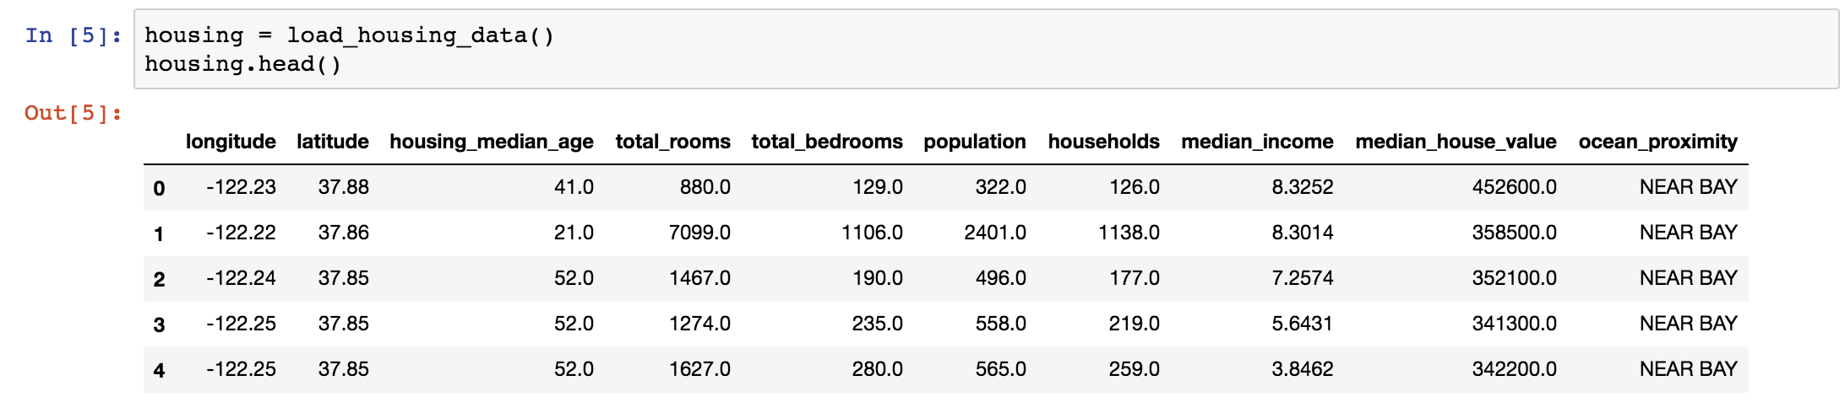
Jupyter notebook
Interactive: code, then see result
support multiple languages: Ruby,Nodejs,Go,Powershell,Python,C,Java,C++

Slide 5
Basic Work Flow
Process Data: Clean empty, handle text, transform
Split train, test dataset
Select Model
Tune Model

Slide 6
Problem:Predict house price
California House Prices dataset(https://raw.githubusercontent.com/ageron/handson-ml/master/datasets/housing/housing.tgz)
a CSV,10 columns, one column is text, and some columns contain empty data

Slide 7
Data Structure
Pandas DataFrame: two dimensional table data structure, a convenient data structure to present, operate data .
a CSV,10 columns, one column is text, and some columns contain empty data

Slide 8
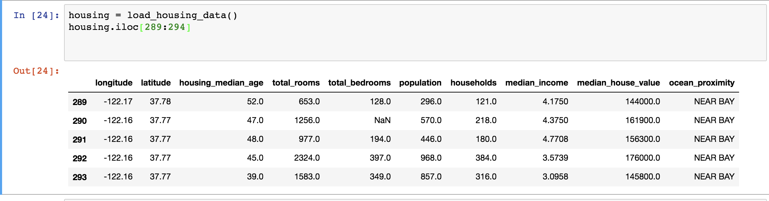



Slide 9
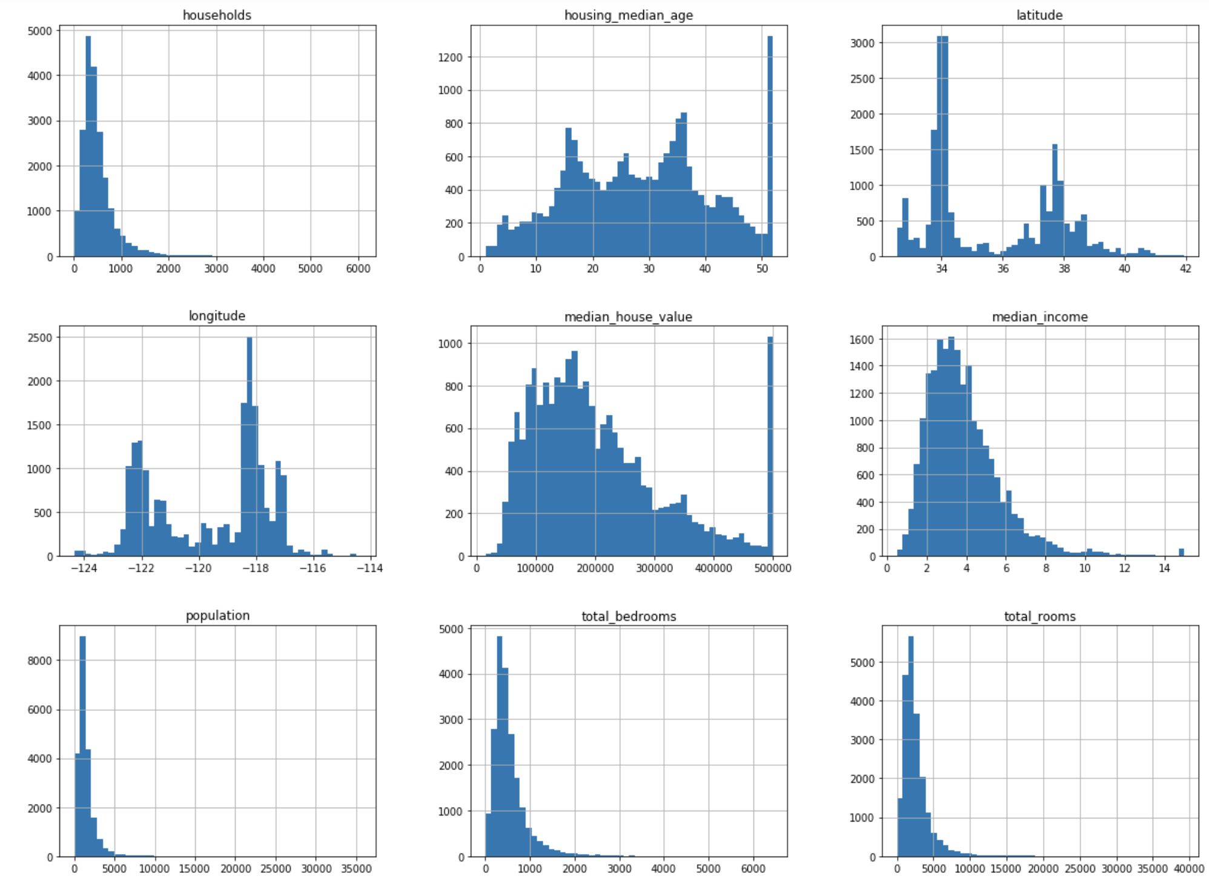
Pandas Visualizing Data
.hist() .

Slide 10
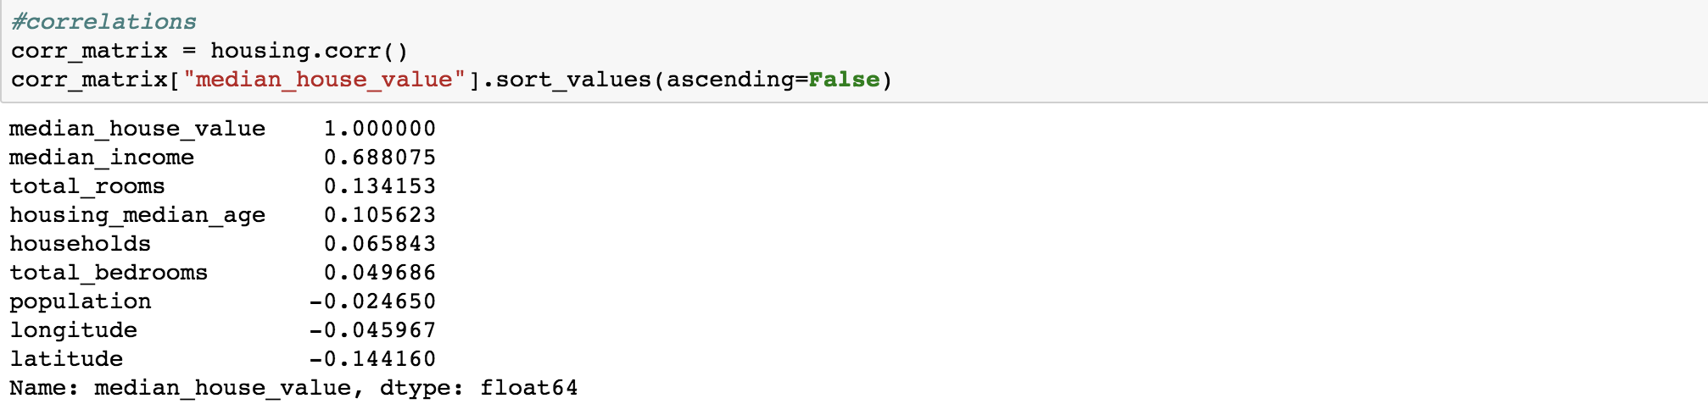
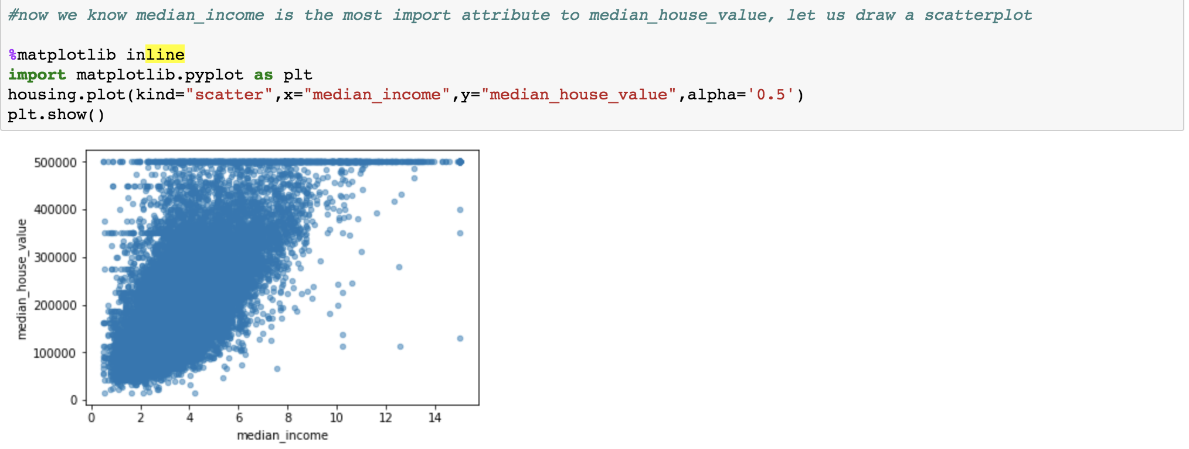
Pandas Visualizing Data
Correlation , which impacts median_house_values most?
Is it a linear mode?

Slide 11
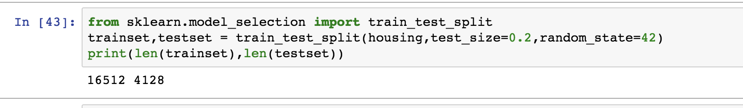
Choose Test sets
Typically 20% of the dataset.
avoid Data-snooping bias: a fixed random seed
Not Best

Slide 12
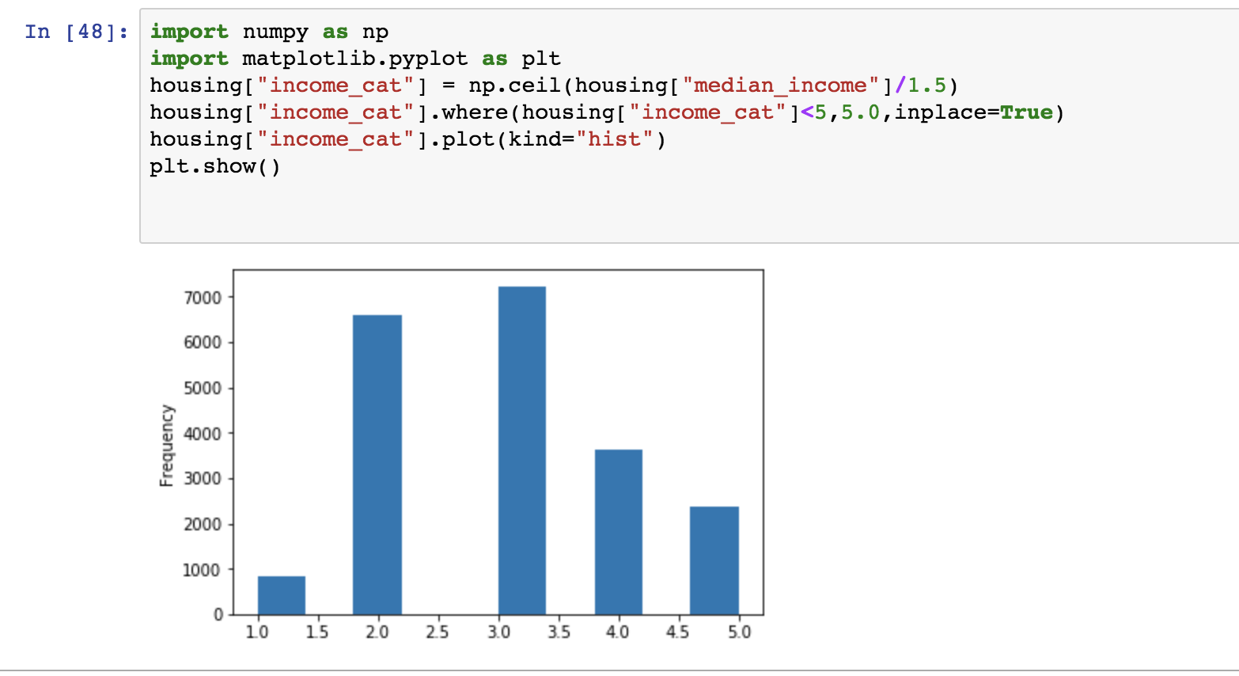
Choose Test sets
Stratified sampling: make sure the sample you choose match strata. for example : the rate between female of male. in our sample, median_income is important, so we need to make sure the sample has all strata.
choose a important attribute (median_income),make sure it match the above

Slide 13
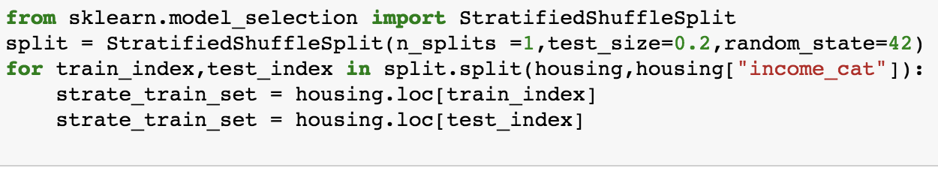
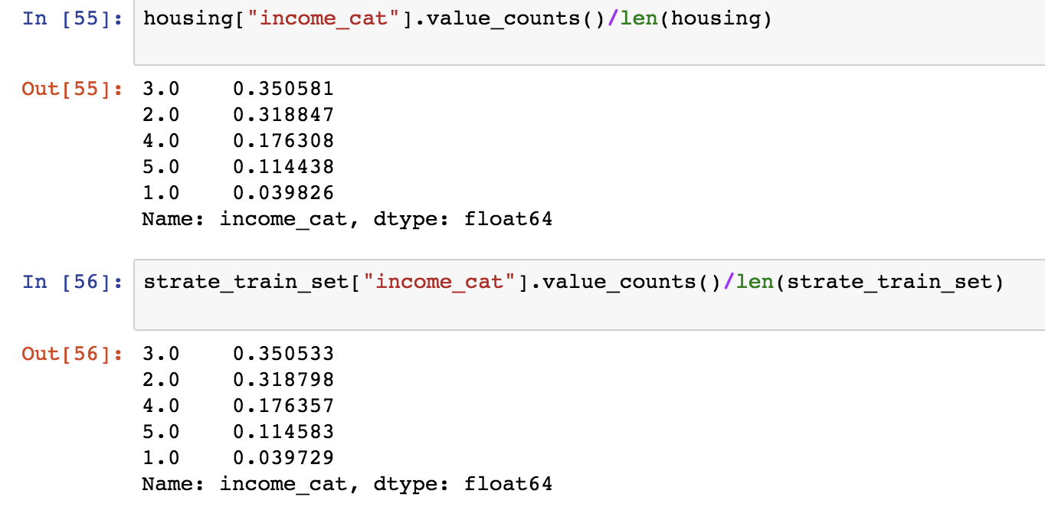
Choose Test sets
Shuffle it:
Make sure the important attribute has the same distribution rate in the test sets.

Slide 14
Clean Data
handle text
LabelEncoder
OneHotEncoder

Slide 15
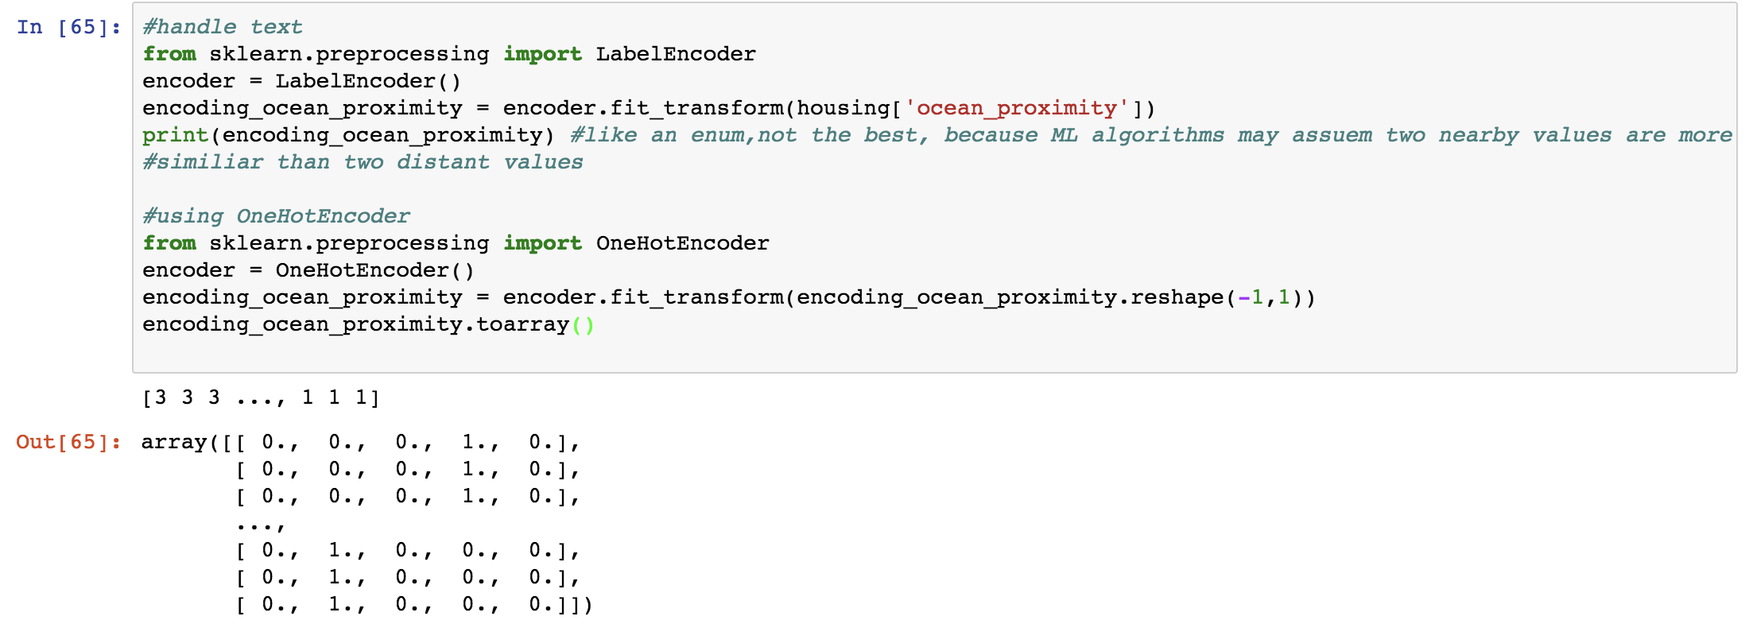

Slide 16
Clean Data
handle missing attributes: replace with the median value (sklearn.preprocessing.Imputer)

Slide 17
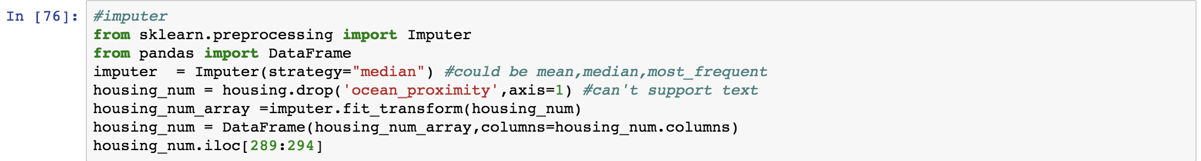
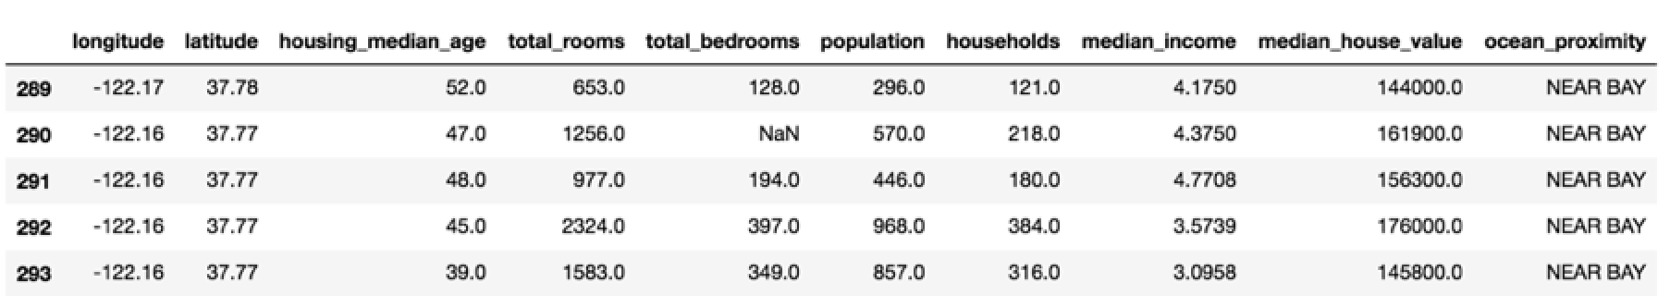
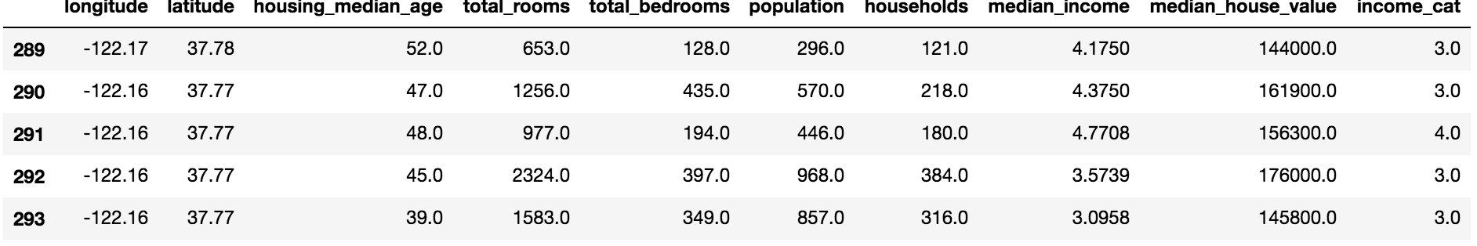
Clean Data

Slide 18
Feature Scaling
ML algorithms don’t perform well when data has very different scales.
Min-max
Standardization

Slide 19
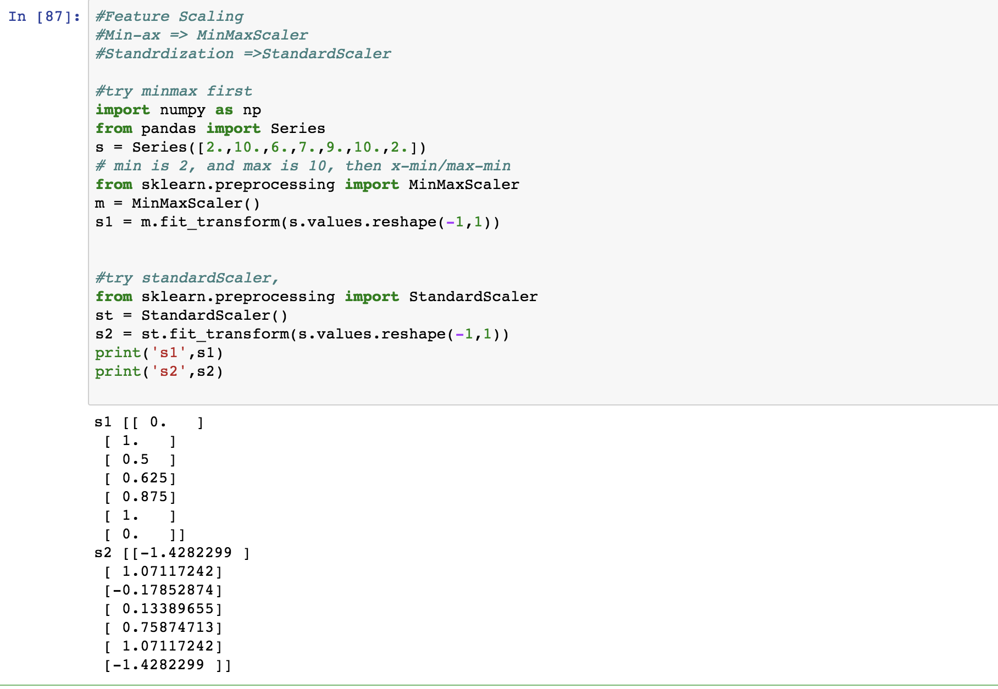
Feature Scaling

Slide 20
Pipeline
Sklearn support put all data-transformer into a pipeline,like this.

Slide 21
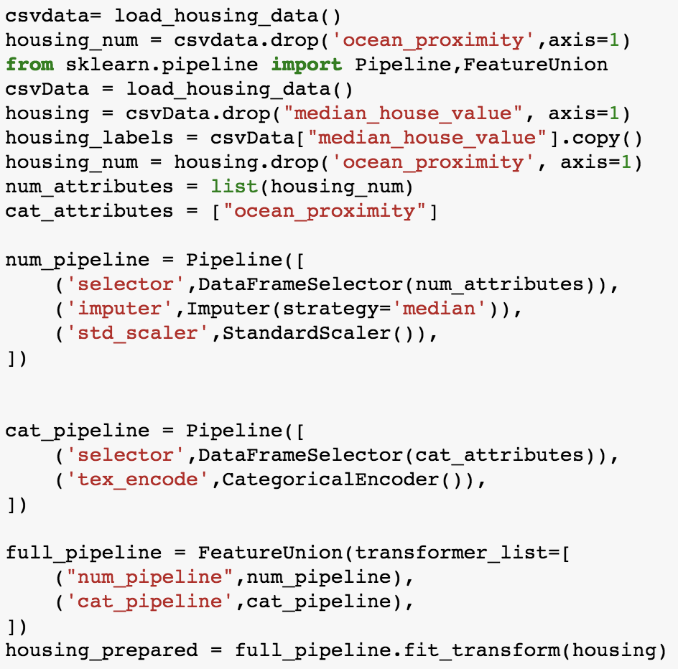
Feature Scaling

Slide 22
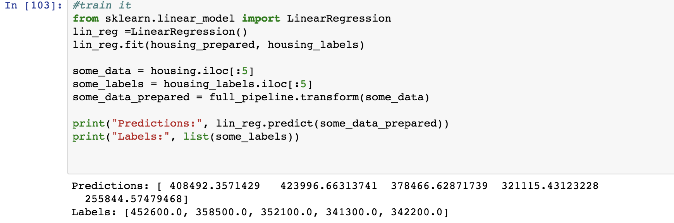
Now we train it
we choose linearRegression first

Slide 23
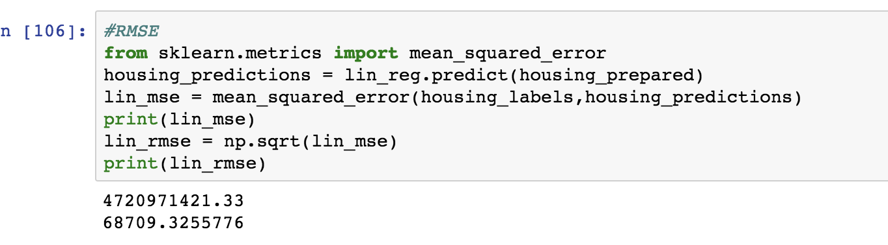
Measure our model
RMSE:Root mean square error

Slide 24
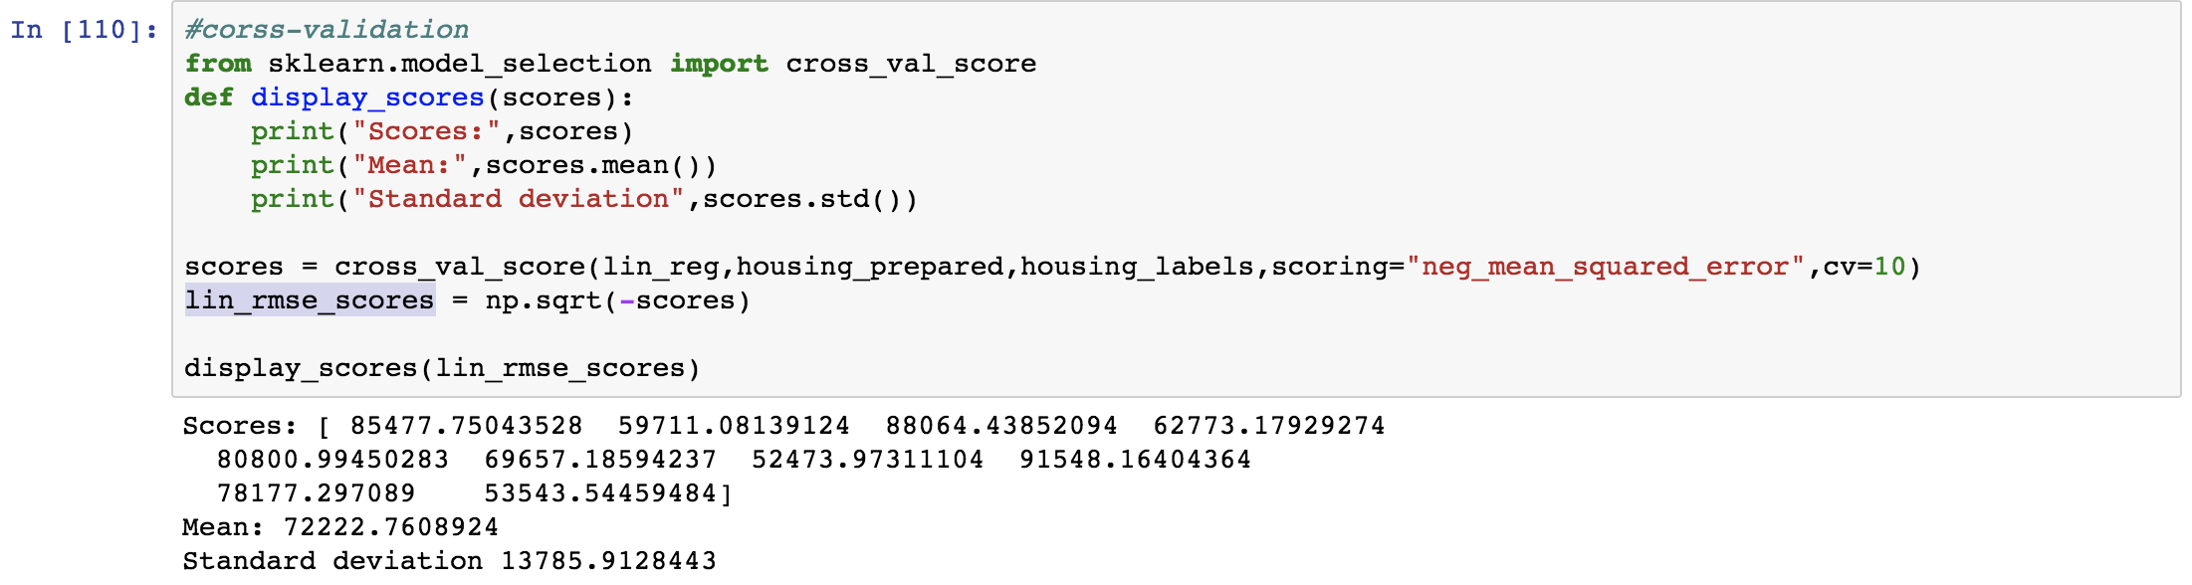
Cross-validation
cross_val_score: K-fold cross-validation,which random splits the training into 10 distinct subsets called folds, then it trains and evaluates the algorithm you choose 10 times, choose a different folder for evaluation every time and training on other 9 folders.

Slide 25
Other Linear algorithms
DecisionTreeRegressor
RandomForestRegressor
SVR..etcf
Nobody know which is better, you need try

Slide 26
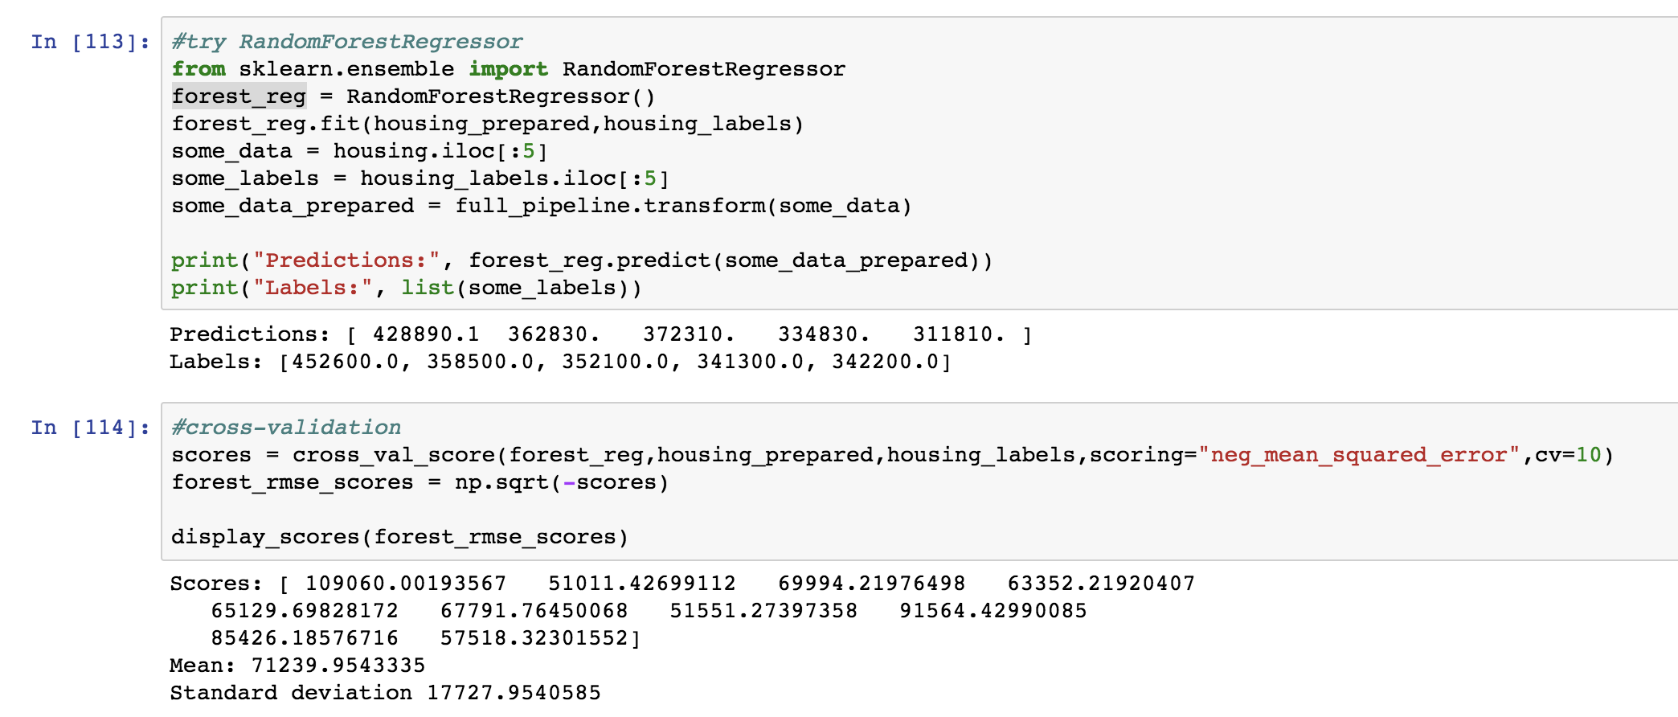
Try RandomForest
Better than Linear

Slide 27
Tune your model
Every algorithm have parameters you can tune.
Grid search
Randomized Search
we are going to tune RandomForest model

Slide 28
How to tune
First, check sklearn api doc to get parameters.
then choose some of them, and compose an test list
Tell GridSearch to start search

Slide 29
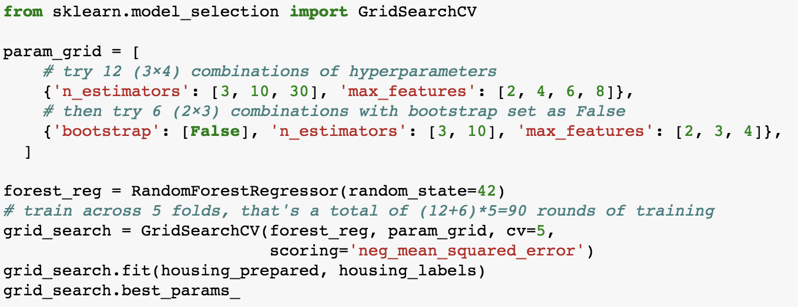
How to tune

Slide 30
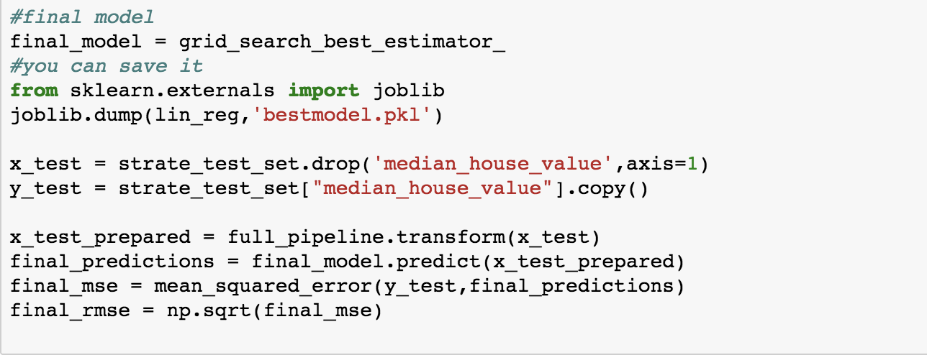
Final test with tuned model

Slide 31
Thanks
the notebook has been put under https://github.com/huangyong7878/iaig/blob/master/lesson1.ipynb

